Slide 1
Polynomial regression without overfitting

Slide 2
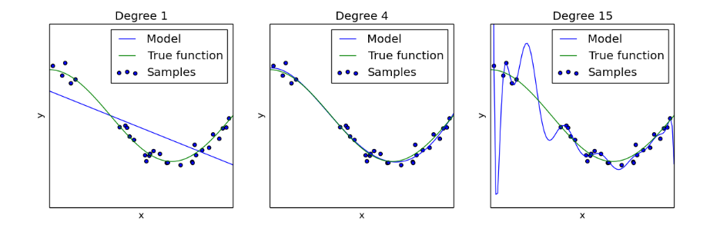
Polynomial regression
Source: sklearn
Polynomials with high degree have a reputation for overfitting.
Usually, we’re advised to use local polynomials or smoothing splines.
Why? Runge’s phenomenon, inherent unsophistication of polynomials.
But polynomials are great!

Slide 3
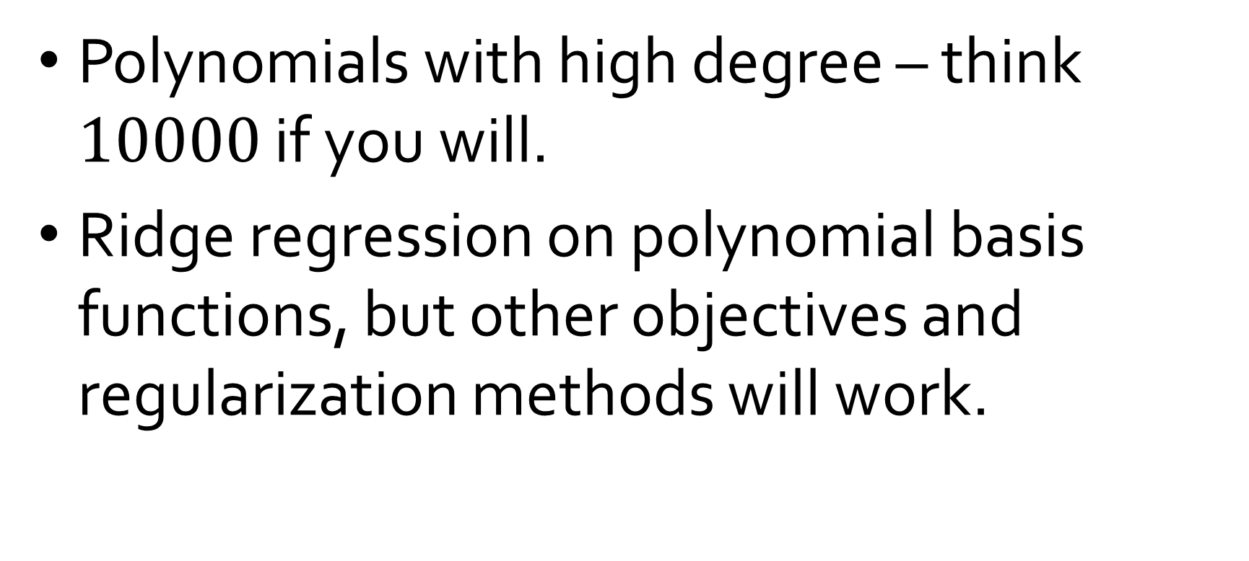
Setting
Polynomials with high degree – think $10000$ if you will.
Ridge regression on polynomial basis functions, but other objectives and regularization methods will work.

Slide 4
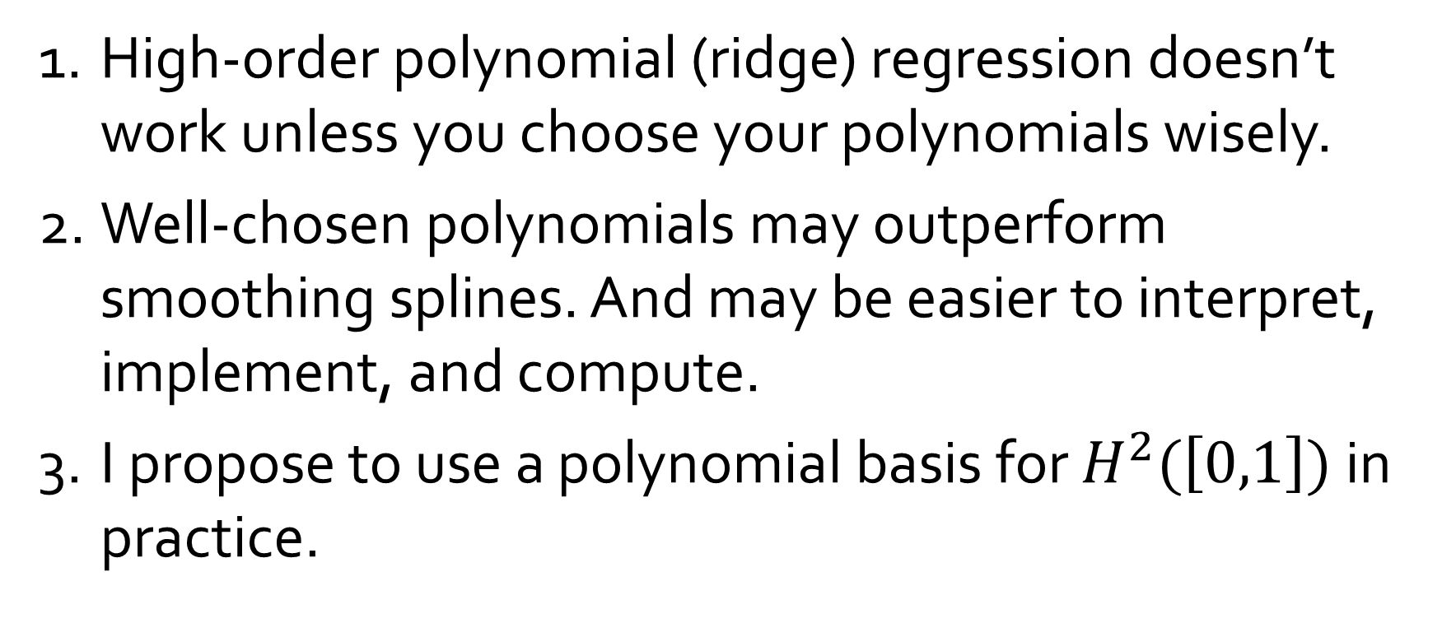
My claims
High-order polynomial (ridge) regression doesn’t work unless you choose your polynomials wisely.
Well-chosen polynomials may outperform smoothing splines. And may be easier to interpret, implement, and compute.
I propose to use a polynomial basis for $H^{2}(\left[0,1\right])$ in practice.

Slide 5
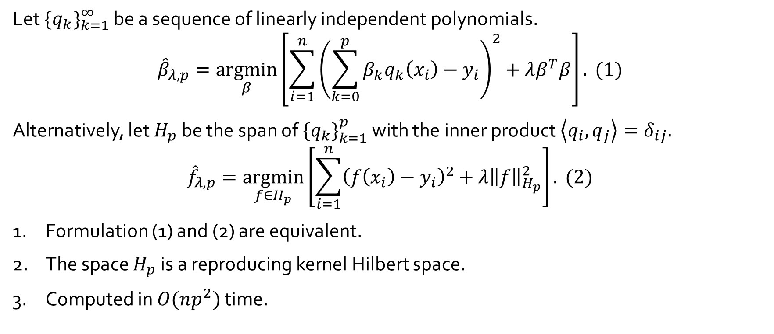
Ridge regression with polynomials
Let ${\{q_{k}\}}_{k=1}^{∞}$ be a sequence of linearly independent polynomials.
$${\hat{β}}_{λ,p}=\underset{β}{argmin}\left[\sum_{i=1}^{n}{{\left(\sum_{k=0}^{p}{β_{k}q_{k}\left(x_{i}\right)}−y_{i}\right)}^{2}}+λβ^{T}β\right]. (1)$$
Alternatively, let $H_{p}$ be the span of ${\{q_{k}\}}_{k=1}^{p}$ with the inner product $\left\langle q_{i},q_{j}\right\rangle =δ_{ij}.$
$${\hat{f}}_{λ,p}=\underset{f∈H_{p}}{argmin}\left[\sum_{i=1}^{n}{{\left(f\left(x_{i}\right)−y_{i}\right)}^{2}}+λ{\left\|f\right\|}_{H_{p}}^{2}\right]. (2)$$
Formulation (1) and (2) are equivalent.
The space $H_{p}$ is a reproducing kernel Hilbert space.
Computed in $O(np^{2})$ time.

Slide 6

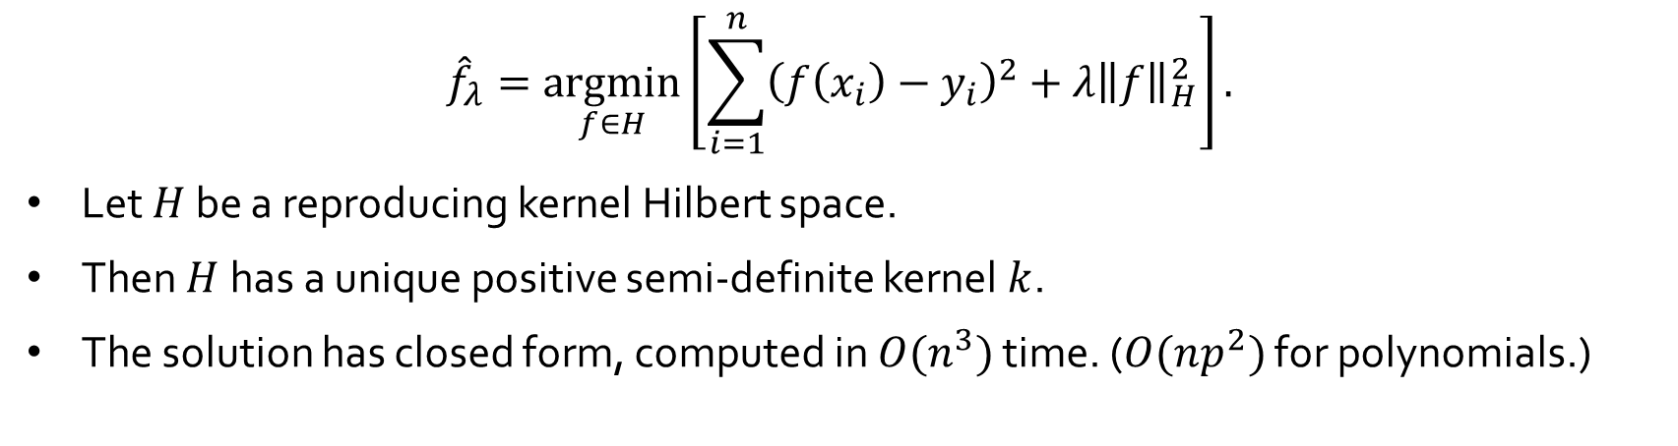
Kernel regression
$${\hat{f}}_{λ}=\underset{f∈H}{argmin}\left[\sum_{i=1}^{n}{{\left(f\left(x_{i}\right)−y_{i}\right)}^{2}}+λ{\left\|f\right\|}_{H}^{2}\right].$$
Let $H$ be a reproducing kernel Hilbert space.
Then $H$has a unique positive semi-definite kernel $k$.
The solution has closed form, computed in $O(n^{3})$ time. ($O(np^{2})$ for polynomials.)
$${\hat{f}}_{λ}\left(x\right)=\sum_{i=1}^{n}{α_{i}k(x,x_{i})\text{,} }$$
$$K\left(i,j\right)=k\left(x_{i},x_{j}\right).$$
$$α={\left(K+λI\right)}^{−1}y,$$

Slide 7
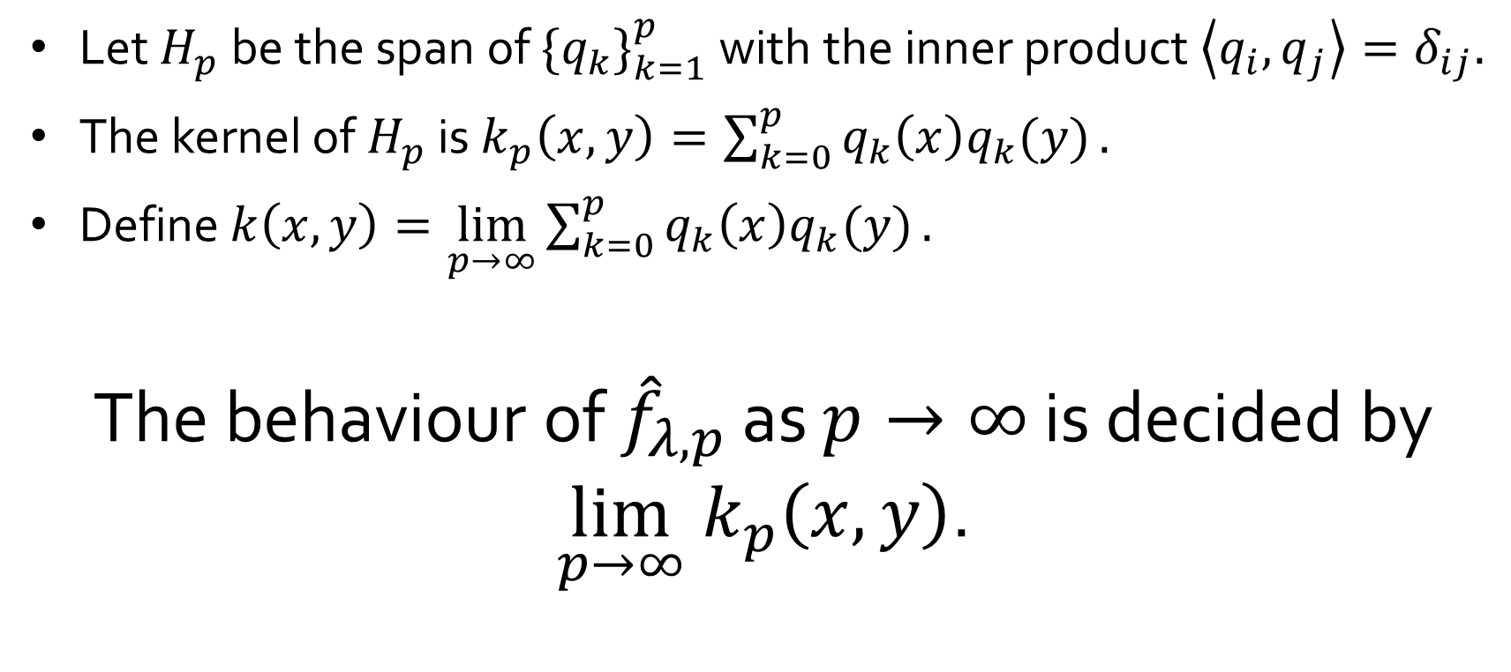

Kernel of $H_{p}$
Let $H_{p}$ be the span of ${\{q_{k}\}}_{k=1}^{p}$ with the inner product $\left\langle q_{i},q_{j}\right\rangle =δ_{ij}.$
The kernel of $H_{p}$ is $k_{p}\left(x,y\right)=\sum_{k=0}^{p}{q_{k}\left(x\right)q_{k}(y)}.$
Define $k\left(x,y\right)=\lim_{p→∞}\sum_{k=0}^{p}{q_{k}\left(x\right)q_{k}(y)}.$
The behaviour of ${\hat{f}}_{λ,p}$ as $p→∞$ is decided by $\lim_{p→∞} k_{p}\left(x,y\right)$.

Slide 8
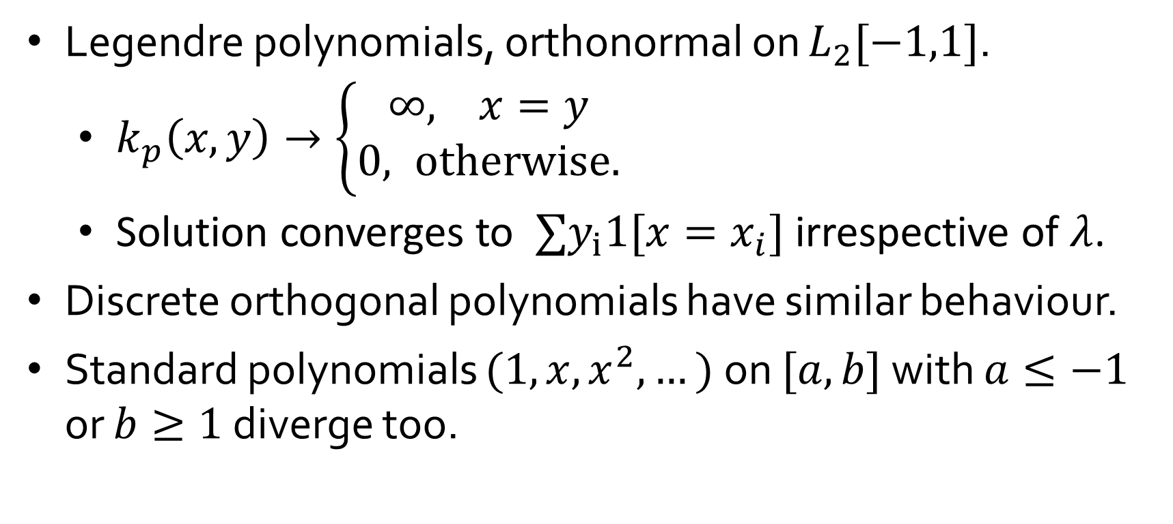

When $k_{p}(x,y)$ diverges
Legendre polynomials, orthonormal on $L_{2}[−1,1]$.
$k_{p}\left(x,y\right)→\left\{\begin{aligned}∞, x=y \\ 0, otherwise.\end{aligned}\right.$
Solution converges to $∑y_{i}1[x=x_{i}]$ irrespective of $λ$.
Discrete orthogonal polynomials have similar behaviour.
Standard polynomials $(1,x,x^{2},…)$ on $[a,b]$ with $a≤−1$ or $b≥1$ diverge too.

Slide 9
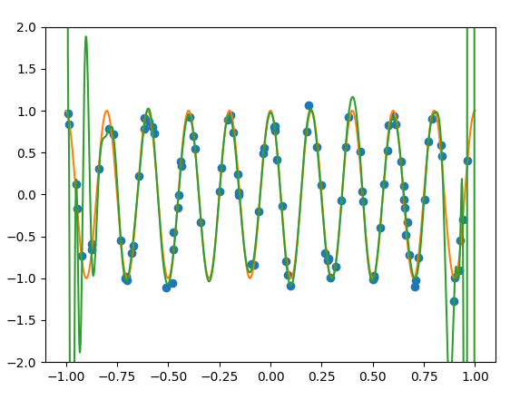
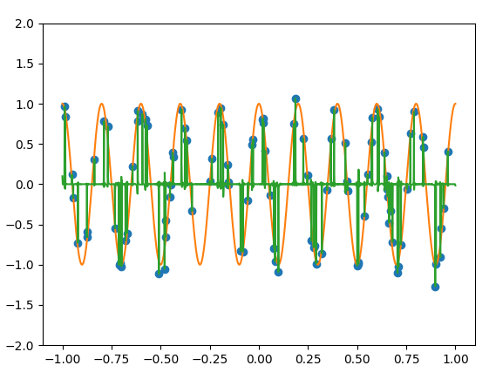
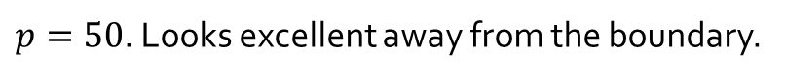

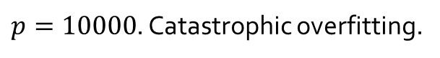
Legendre polynomials ($λ=10^{−7}$; $n=100$)
$p=50$. Looks excellent away from the boundary.
$p=10000$. Catastrophic overfitting.

Slide 10
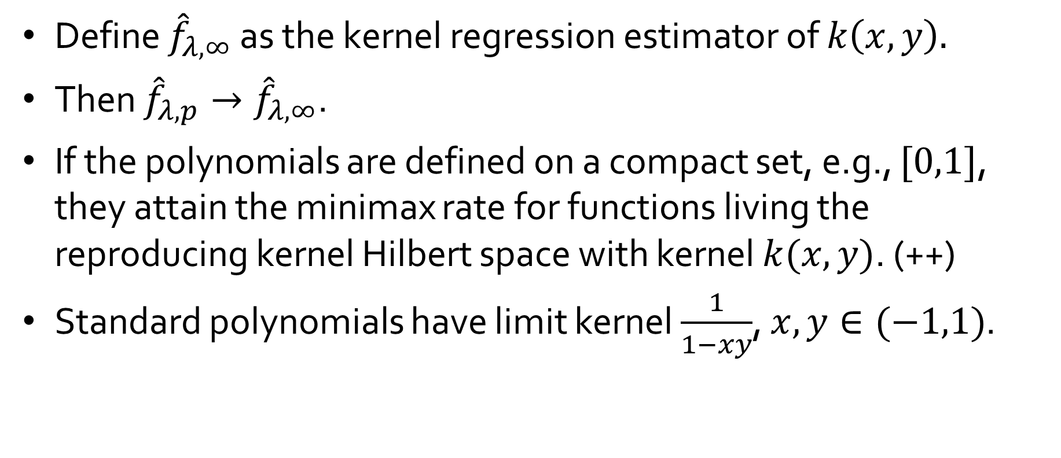

When $k_{p}(x,y)$ converges
Define ${\hat{f}}_{λ,∞} \text{as} \text{the} \text{kernel} \text{regression} \text{estimator} \text{of} k\left(x,y\right).$
Then ${\hat{f}}_{λ,p}→{\hat{f}}_{λ,∞}$.
If the polynomials are defined on a compact set, e.g., $[0,1]$, they attain the minimax rate for functions living the reproducing kernel Hilbert space with kernel $k(x,y)$. (++)
Standard polynomials have limit kernel $\frac{1}{1−xy}$, $x,y∈(−1,1)$.

Slide 11
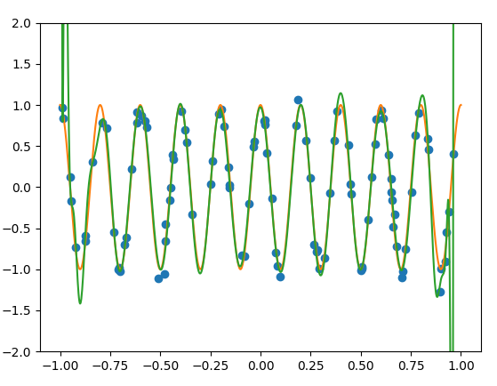
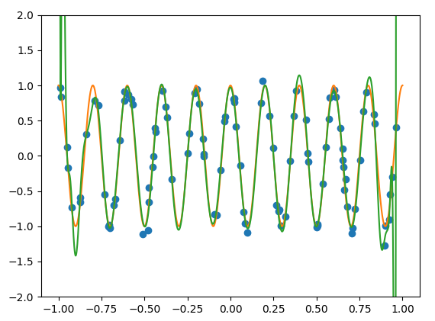
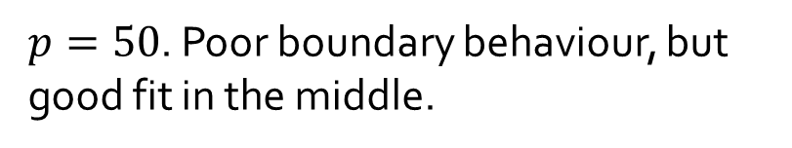

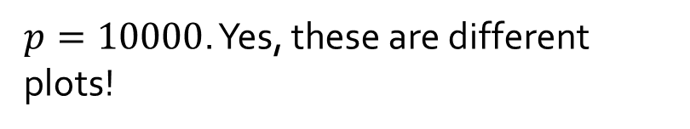
Standard polynomials ($λ=10^{−23}$)
$p=50$. Poor boundary behaviour, but good fit in the middle.
$p=10000$. Yes, these are different plots!

Slide 12
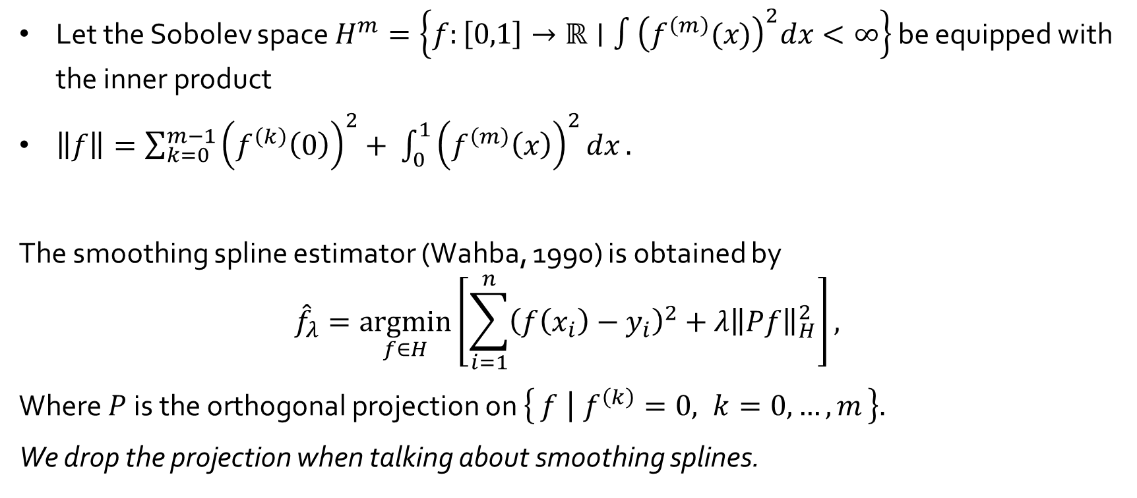
Smoothing splines
Let the Sobolev space $H^{m}=\left\{f:\left[0,1\right]→ℝ∣∫{\left(f^{\left(m\right)}(x)\right)}^{2}dx<∞\right\}$ be equipped with the inner product
$\left\|f\right\|=\sum_{k=0}^{m−1}{{\left(f^{\left(k\right)}\left(0\right)\right)}^{2}+ \int_{0}^{1}{{\left(f^{\left(m\right)}\left(x\right)\right)}^{2}dx}}.$
The smoothing spline estimator (Wahba, 1990) is obtained by
$${\hat{f}}_{λ}=\underset{f∈H}{argmin}\left[\sum_{i=1}^{n}{{\left(f\left(x_{i}\right)−y_{i}\right)}^{2}}+λ{\left\|Pf\right\|}_{H}^{2}\right],$$
Where $P$ is the orthogonal projection on $\left\{f ∣ f^{\left(k\right)}=0, k=0,…,m\right\}.$
We drop the projection when talking about smoothing splines.

Slide 13
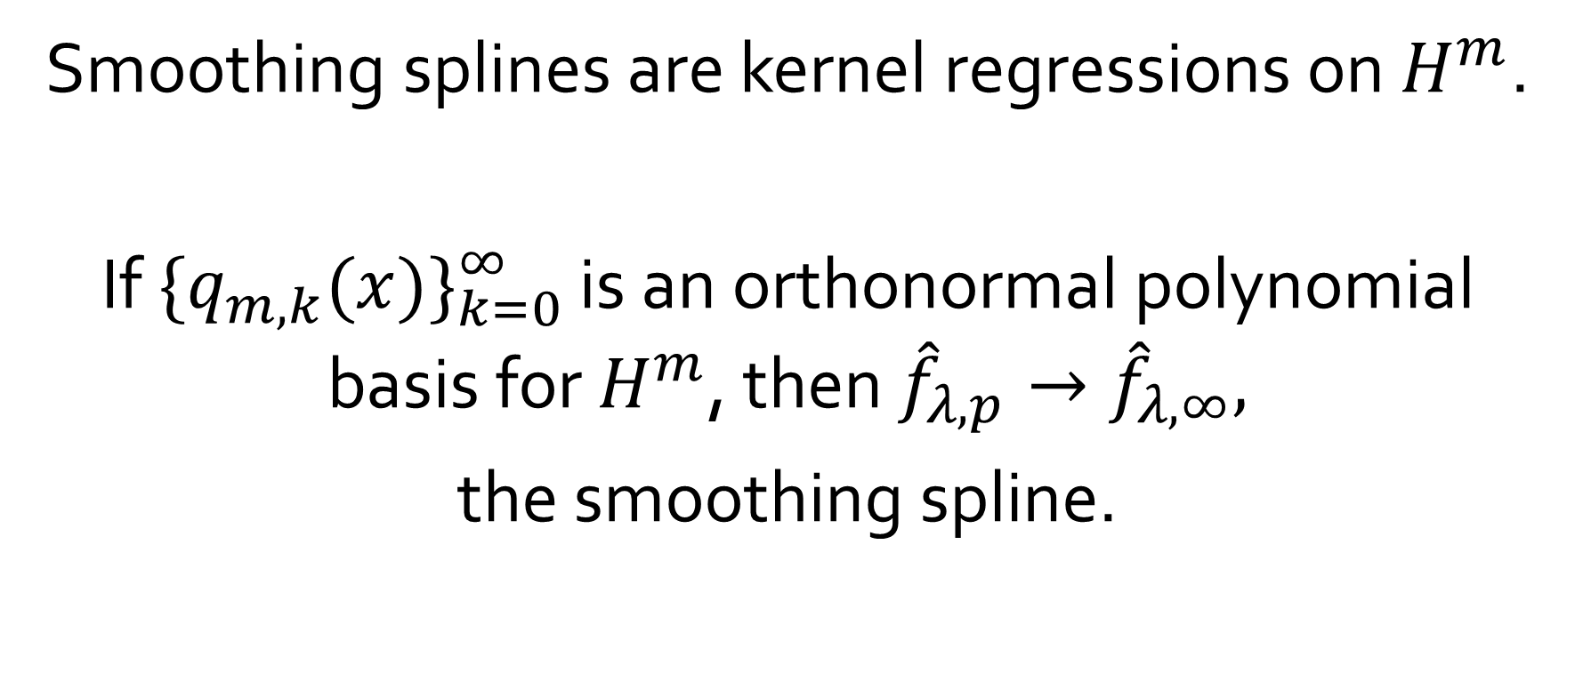
Constructing a basis
Smoothing splines are kernel regressions on $H^{m}$.
If ${\{q_{m,k}(x)\}}_{k=0}^{∞}$ is an orthonormal polynomial basis for $H^{m}$, then ${\hat{f}}_{λ,p}→{\hat{f}}_{λ,∞},$
the smoothing spline.

Slide 14
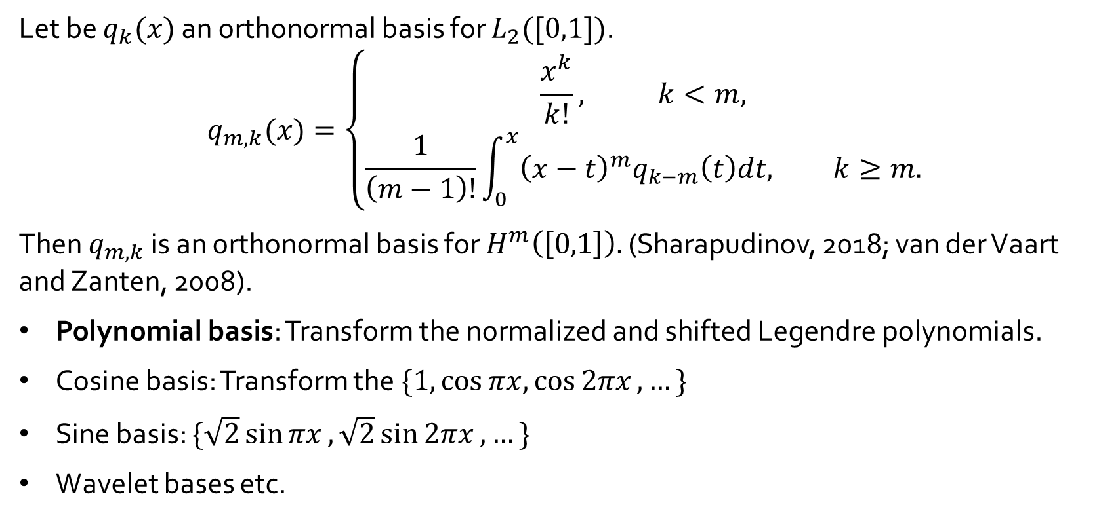

Transforming bases of $L_{2}[0,1]$
Let be $q_{k}(x)$ an orthonormal basis for $L_{2}([0,1])$.
$$q_{m,k}(x)=\left\{\begin{aligned}\frac{x^{k}}{k!}, k<m, \\ \frac{1}{\left(m−1\right)!}\int_{0}^{x}{{\left(x−t\right)}^{m}q_{k−m}\left(t\right)dt, k≥m.}\end{aligned}\right.$$
Then $q_{m,k}$ is an orthonormal basis for $H^{m}\left(\left[0,1\right]\right).$ (Sharapudinov, 2018; van der Vaart and Zanten, 2008).
Polynomial basis: Transform the normalized and shifted Legendre polynomials.
Cosine basis: Transform the $\{1,\cos{πx,\cos{2πx},…\}}$
Sine basis: $\{\sqrt{2}\sin{πx},\sqrt{2}\sin{2πx},…\}$
Wavelet bases etc.

Slide 15

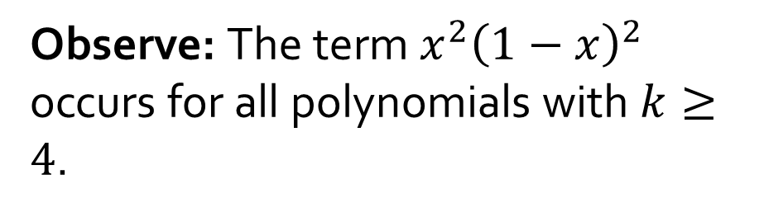
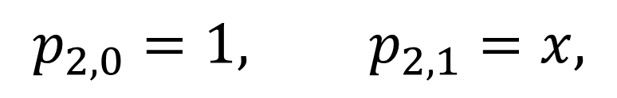
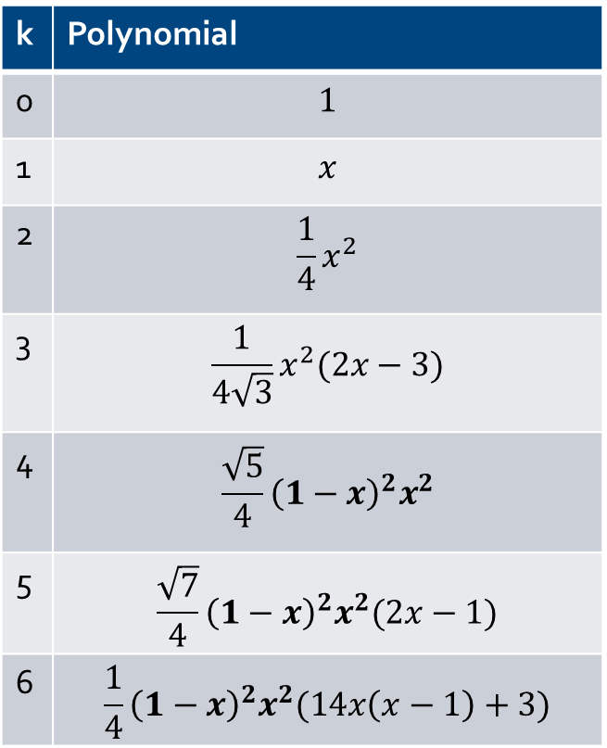

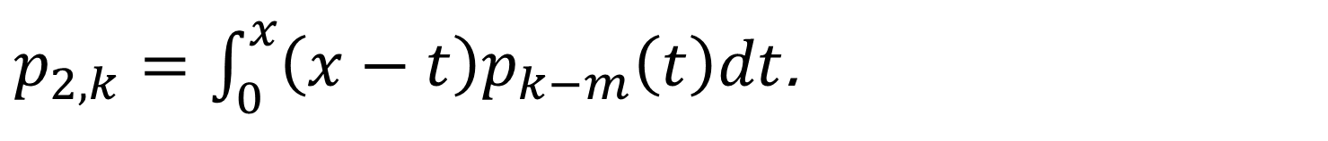
A polynomial basis for $H^{2}\left(\left[0,1\right]\right)$
$$p_{2,0}=1, p_{2,1}=x,$$
k | Polynomial
0 | $$1$$
1 | $$x$$
2 | $$\frac{1}{4}x^{2}$$
3 | $$\frac{1}{4\sqrt{3}}x^{2}(2x−3)$$
4 | $$\frac{\sqrt{5}}{4}{\left(1−x\right)}^{2}x^{2}$$
5 | $$\frac{\sqrt{7}}{4}{\left(1−x\right)}^{2}x^{2}(2x−1)$$
6 | $$\frac{1}{4}{\left(1−x\right)}^{2}x^{2}(14x\left(x−1\right)+3)$$
$p_{2,k}=\int_{0}^{x}{\left(x−t\right)p_{k−m}\left(t\right)dt}$.
Unique orthonormal polynomial basis for $H^{2}\left(\left[0,1\right]\right)$.
Observe: The term $x^{2}{\left(1−x\right)}^{2}$ occurs for all polynomials with $k≥4$.
Can be computed efficiently using a recursive formula.

Slide 16
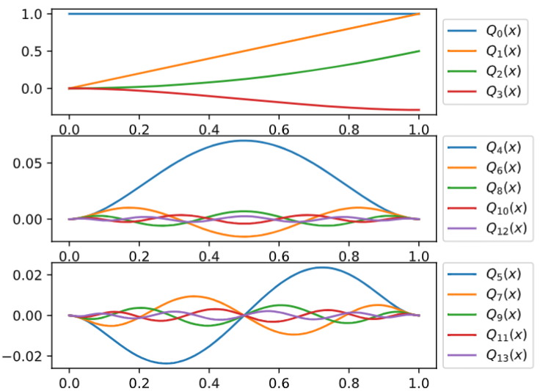
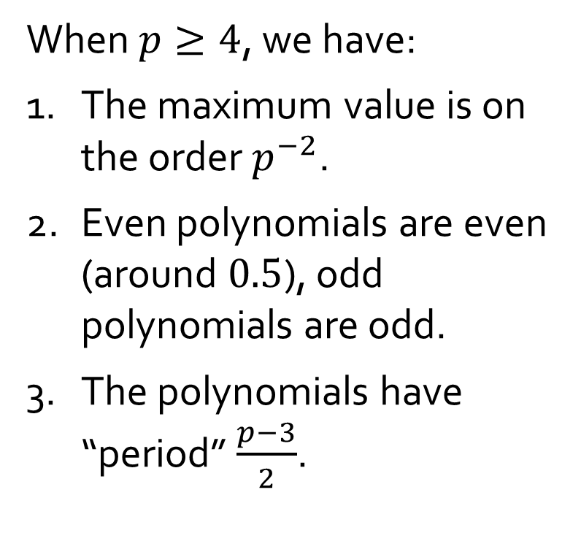

A polynomial basis for $H^{2}\left(\left[0,1\right]\right)$
When $p≥4$, we have:
The maximum value is on the order $p^{−2}$.
Even polynomials are even (around $0.5$), odd polynomials are odd.
The polynomials have “period” $\frac{p−3}{2}$.

Slide 17
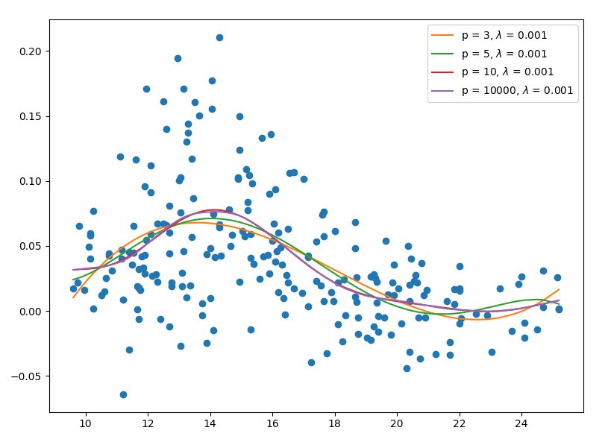
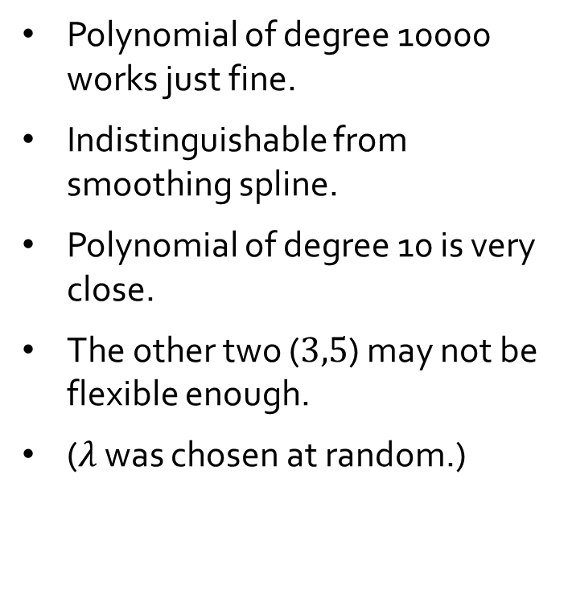
Example: Bone mineral density
Polynomial of degree 10000 works just fine.
Indistinguishable from smoothing spline.
Polynomial of degree 10 is very close.
The other two ($3,5$) may not be flexible enough.
($λ$ was chosen at random.)

Slide 18
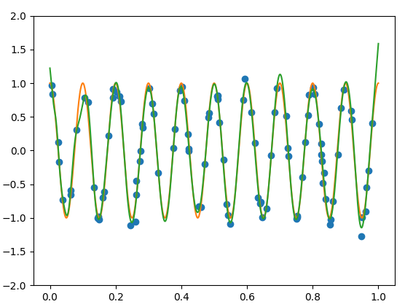
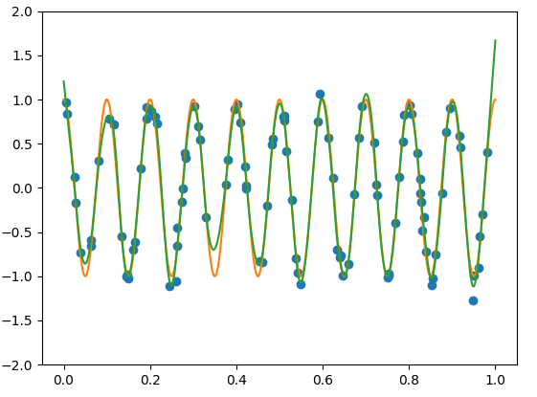
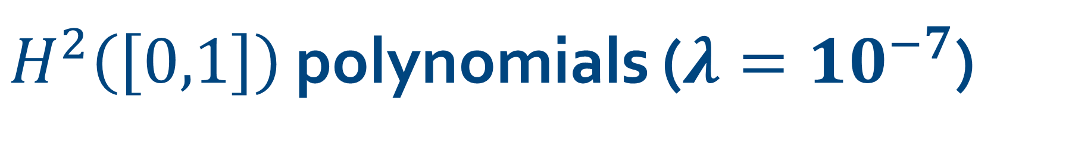
$H^{2}\left(\left[0,1\right]\right)$ polynomials ($λ=10^{−7}$)
(left) $p=50$ ,(right) $p=10000.$

Slide 19
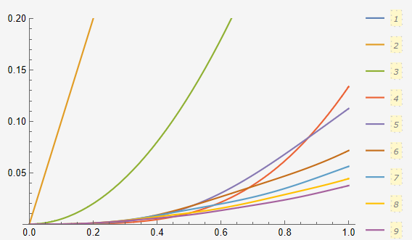
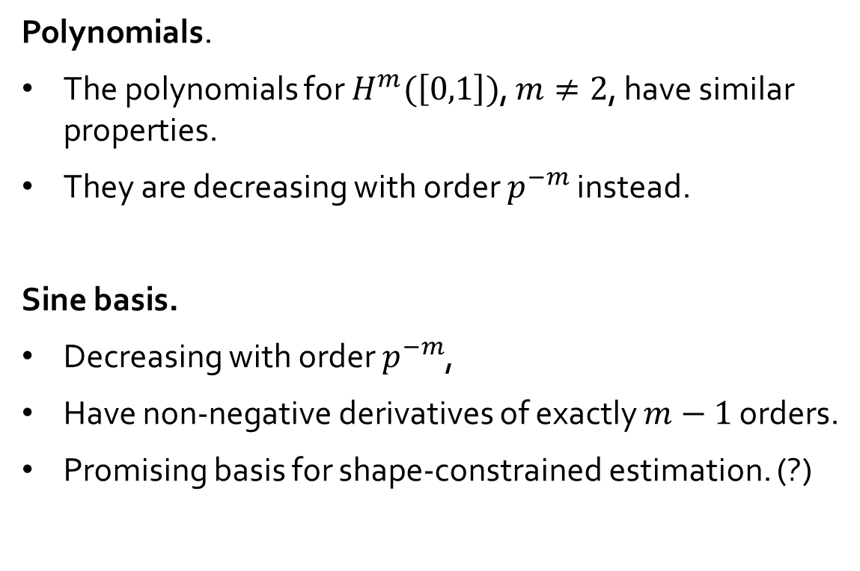

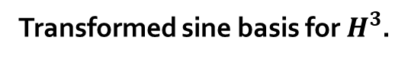
Other bases for $H^{m}\left(\left[0,1\right]\right)$
Polynomials.
The polynomials for $H^{m}(\left[0,1\right])$, $m≠2$, have similar properties.
They are decreasing with order $p^{−m}$ instead.
Sine basis.
Decreasing with order $p^{−m}$,
Have non-negative derivatives of exactly $m−1$ orders.
Promising basis for shape-constrained estimation. (?)
Transformed sine basis for $H^{3}$.

Slide 20
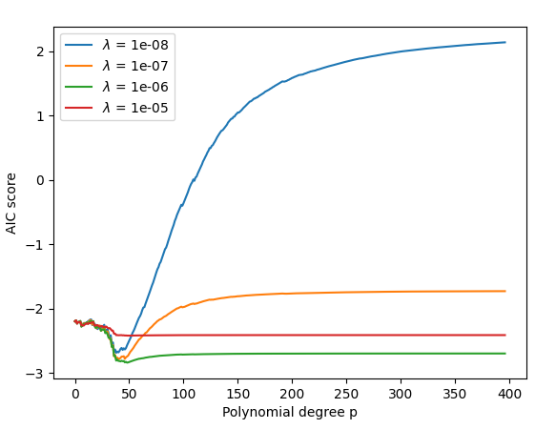
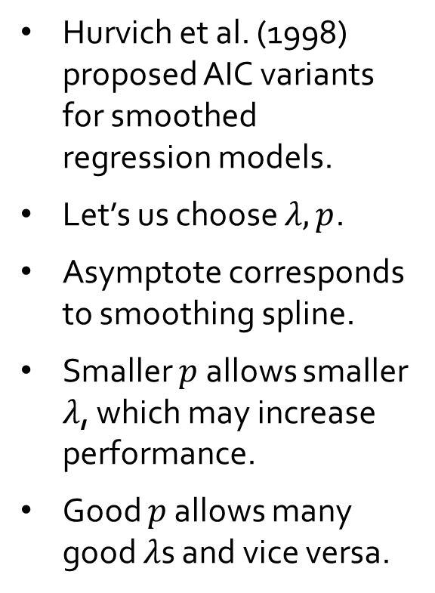

The $AIC_{C_{1}}$ as a function of $λ$ and $p$
Hurvich et al. (1998) proposed AIC variants for smoothed regression models.
Let’s us choose $λ,p$.
Asymptote corresponds to smoothing spline.
Smaller $p$ allows smaller $λ$, which may increase performance.
Good $p$ allows many good $λ$s and vice versa.

Slide 21
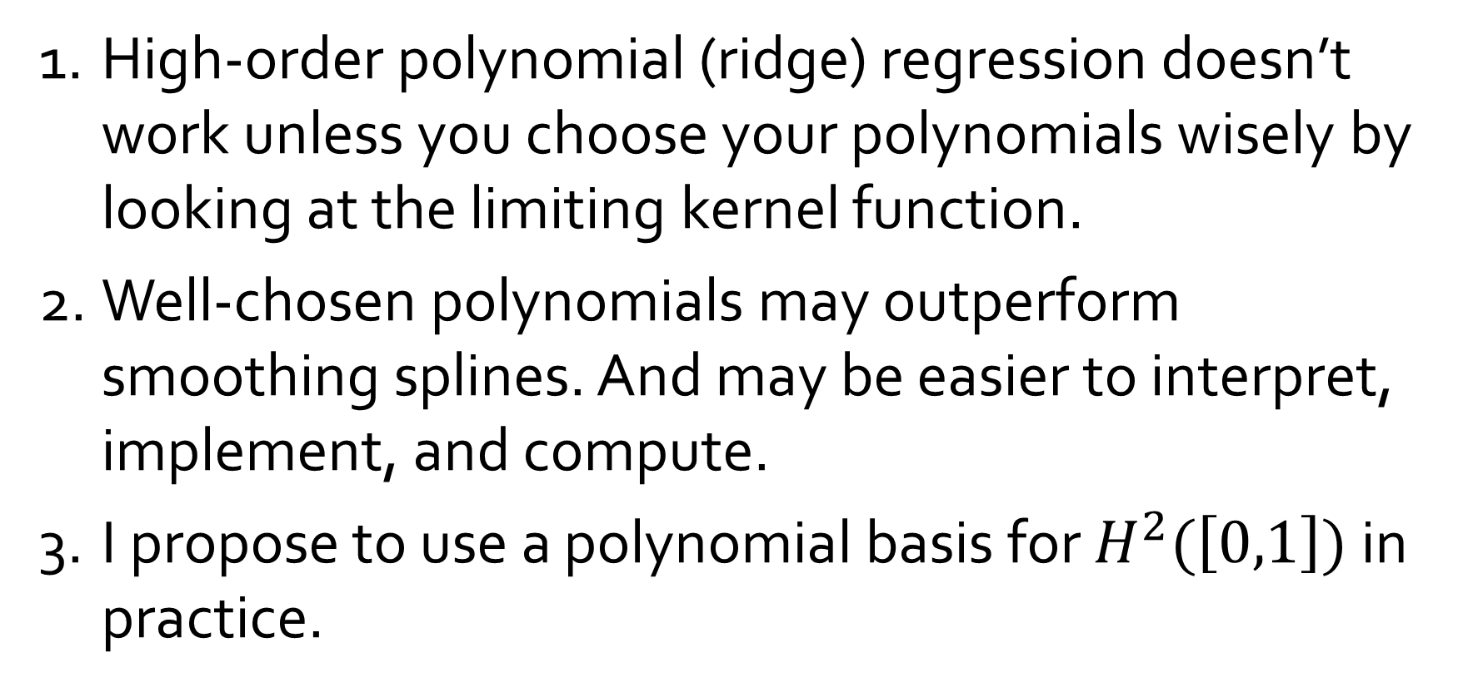
Conclusion
High-order polynomial (ridge) regression doesn’t work unless you choose your polynomials wisely by looking at the limiting kernel function.
Well-chosen polynomials may outperform smoothing splines. And may be easier to interpret, implement, and compute.
I propose to use a polynomial basis for $H^{2}(\left[0,1\right])$ in practice.

